Slide 1
Lightning Talk 7 - Prototyping
Group: sdmay25-16

Slide 2
Client: Manojit Pramanik
Advisor: Avishek Das

Slide 3
Project Overview
Problem Statement: Design and build an 8/16 channel amplifier with little noise to boost ultrasound signals received for the acoustic imaging system. Include casing for the multichannel system.
Constraints:
Low noise
Low input impedance
Bandpass filtering: 10k-1MHz
Low size (< 5x5 cm)
ESD protection

Slide 4
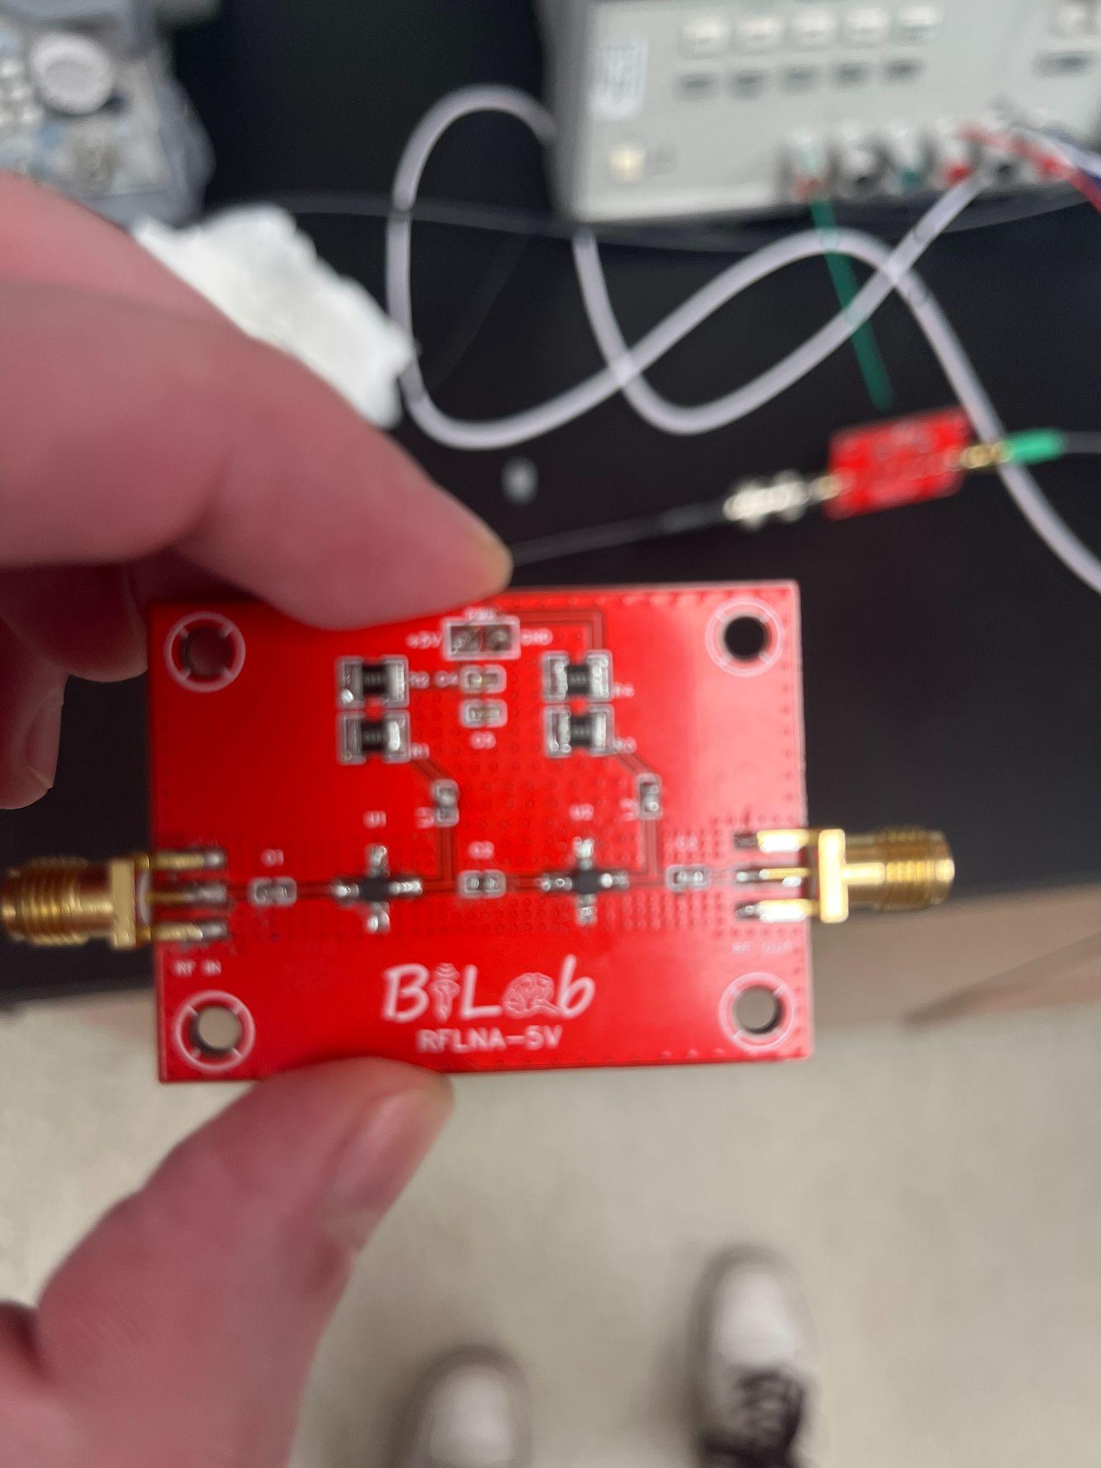
First Prototype
Initially tried 2 stages of amplification as seen on the right
Changed components
Tried removing a stage of amplification to figure out what is wrong
Changing components of this, comparing resulting waveforms

Slide 5
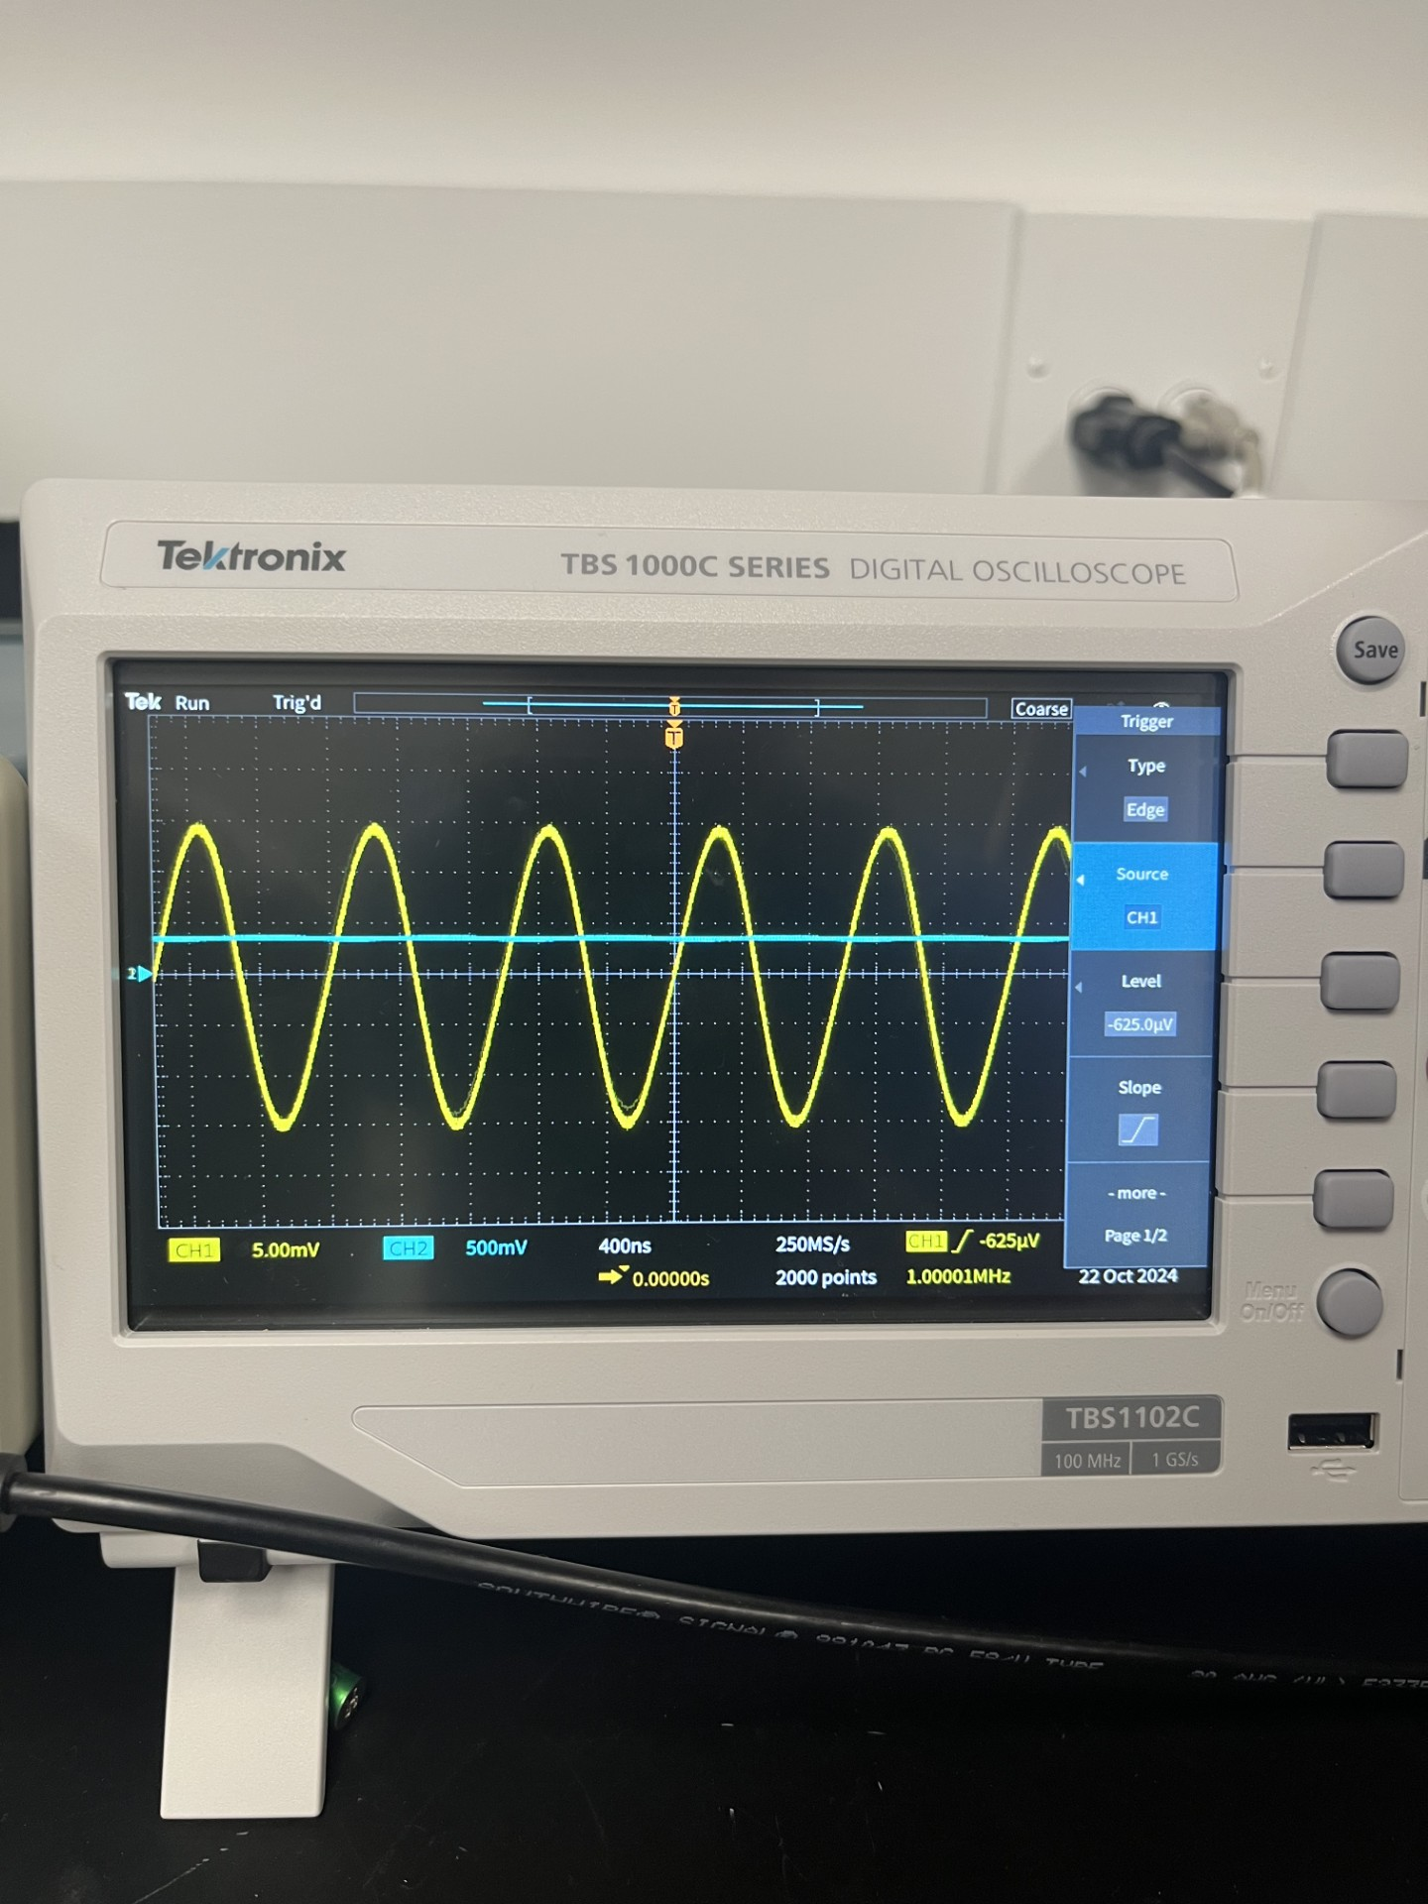
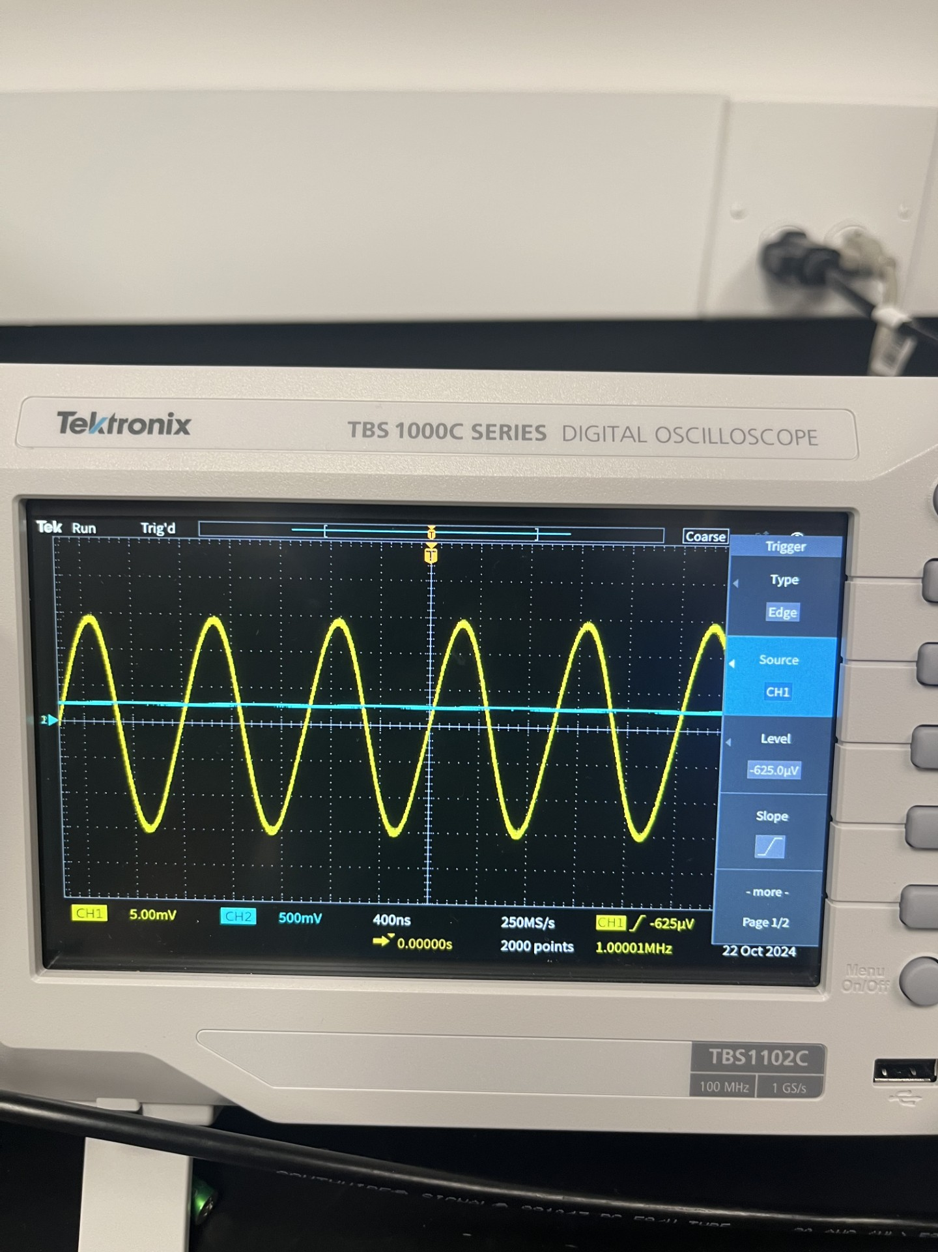
An Example of results from First Prototype
Output voltage waveform before and after changing capacitor values

Slide 6
Learning from First Prototype
Found clipping that occurs at higher voltages, limiting our gain
General knowledge of how the circuit works after testing that are not shown in simulations
How changing each component can influence other parts of the circuit
Figuring out why it performs slightly differently than our simulations have

Slide 7
Next Steps
We are done with our simulations and we have ordered parts for a new prototype that we will build to do more testing on. We hope that this new design will work better and provide more insight on why the initial prototype wasn’t working as expected.

Slide 8
Conclusions
We have used the prototype to help us learn about how the circuit is working more accurately than the simulations can give us. We are planning on building another one that will build upon what we have learned and changed so far.

